Slide 1


Slide 2

Problem in Existing Tiffin Service
Low Food Quality
High Pricing
Unorganized Tiffin Services

Slide 3
Vision
To provide a highly flexible and systematic digital platform for new and pre existing tiffin systems, empowering women and people welfare
Mission
To promote women empowerment by providing extra source of income & To provide high quality tiffin service

Slide 4
Targeted Audience
Service provider
Housewives
Local Tiffin System
Restaurants
User
Students
Employees

Slide 5



Service Providers
Local Tiffin Service
We will tie-up with the existing tiffin services and provide them new Users
Housewives
We will provide fundamental raw materials to housewives and a dashboard to manage their services
Restaurants
We will integrate the pre-existing thali system in our timely organized tiffin service

Slide 6
Rules For Service Providers
They have to verify food related certificates issued by G.O.I.
Maintain food quality & hygiene
They have to maintain proper rating & react towards customer review
Decide weekly menu according to customers

Slide 7

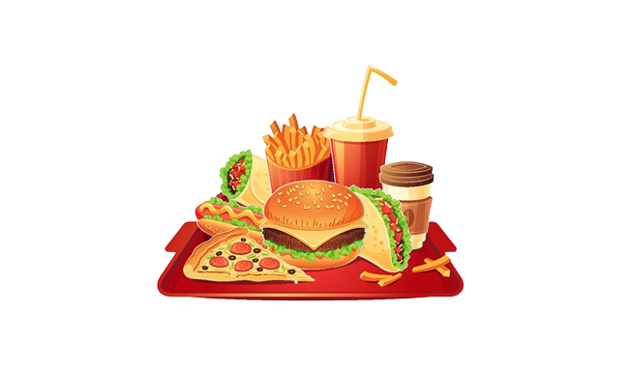

User
Basic Subscription
User can select any one of service provider permanently
Prime Subscription
User have freedom to choose their service provider on weekly basis
Add-On
We Will Provide Add-On With Meal

Slide 8

User Flexibility
User can cancel subscription after a particular time
User can pause their subscription at any time
User have power to complaint about the services

Slide 9

Delivery System
Initially, we will deliver using rental bikes by ourself, this will cost Rs. 3000 for two bikes per month.
After reaching our milestone of 100 customers, we will start hiring delivery boys, which will cost Rs.7,200.
We will not take delivery charges on tiffins, but on add-ons.

Slide 10
U.S.P.
We will assist women in generating a stable revenue source by providing an interactive and clean dashboard
We are providing an organized system to local pre-existing tiffin services
We are providing homemade food to user

Slide 11
This Deck Is Not Everything
Mega Kitchen Concept
Fresh Kitchen
Food Chain Services

Slide 12


